Slide 1


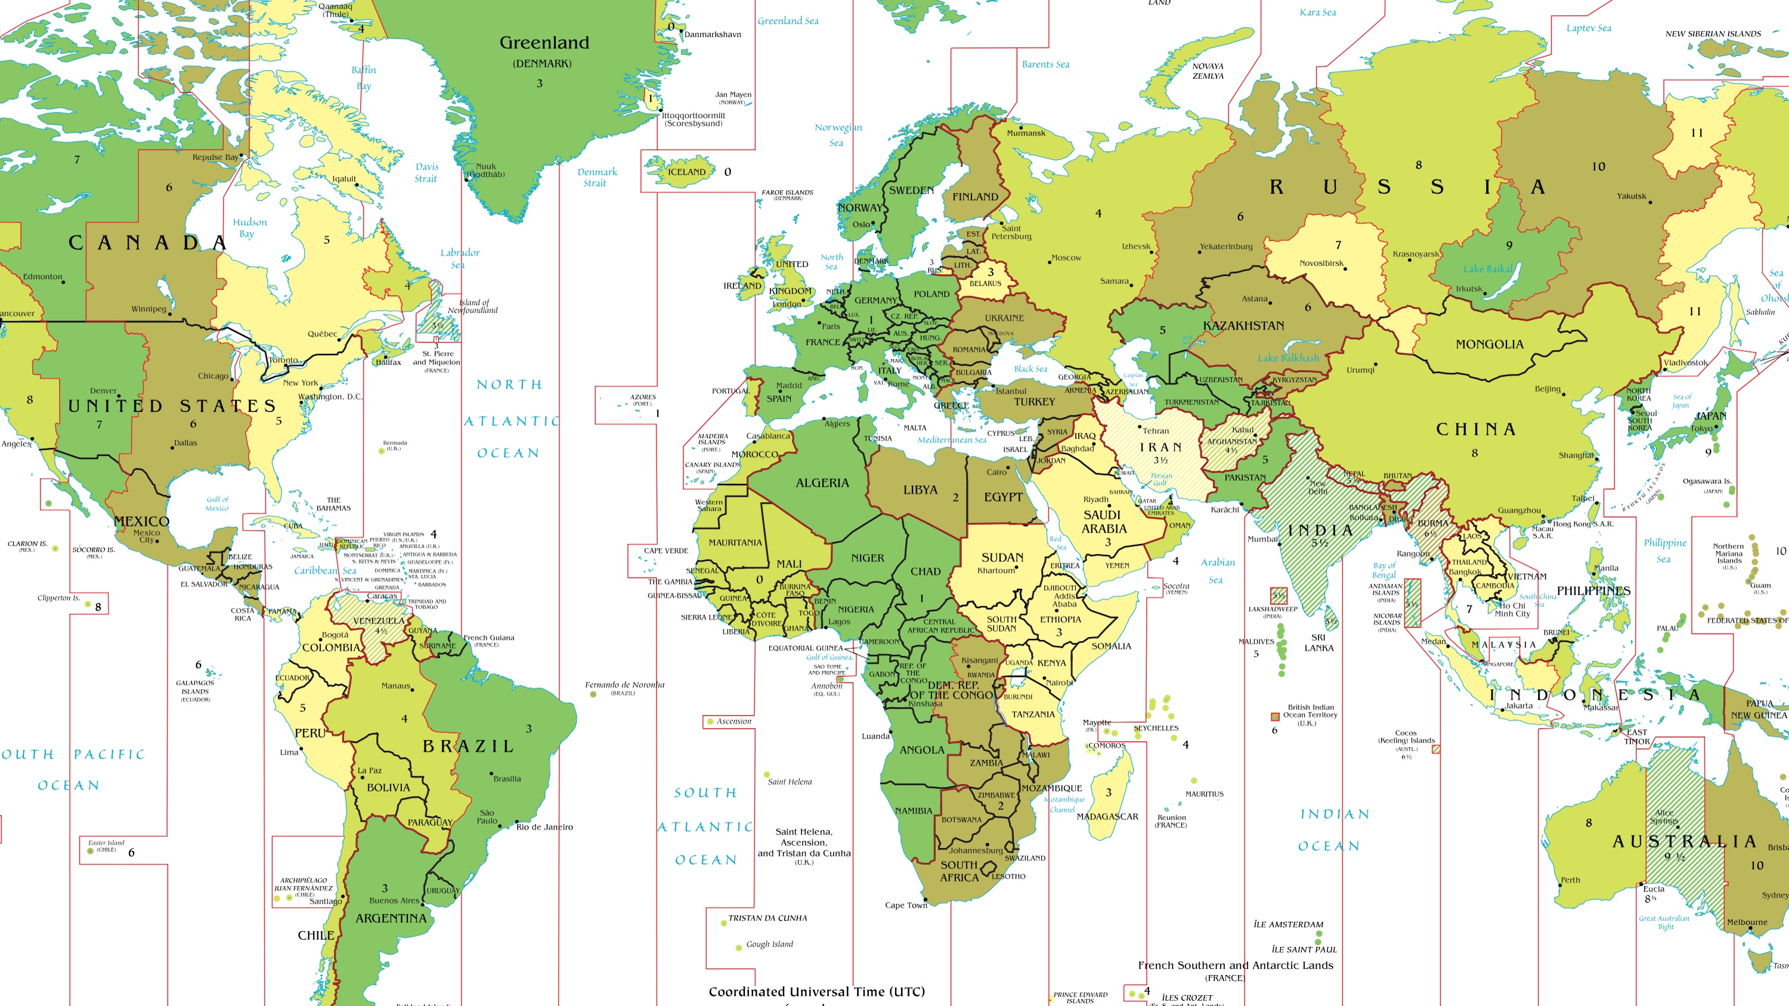
Time in Navigation
NN220-11
SEANAV I United States Naval Academy
NN220 – Fundamentals of Navigation– Updated May 2023
Operations Officer I HMS PROTECTOR A173 I The Ice Patrol Ship

Slide 2
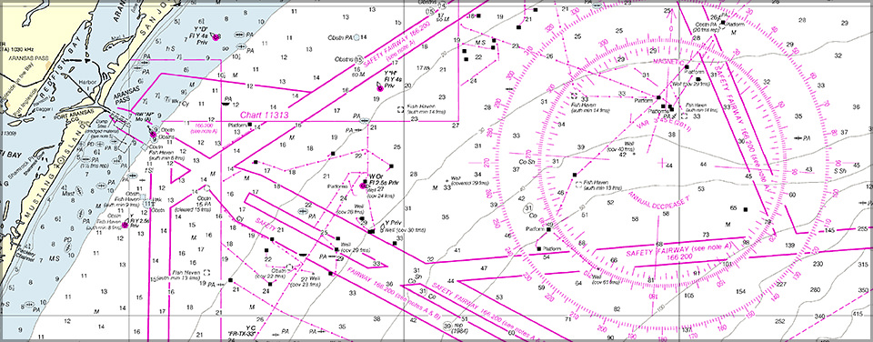
References
-The American Practical Navigator, Pub. No. 9, Bowditch, VOL. 1, 2019 Edition -Surface Ship Navigation Department Organizations and Regulations Manual (NAVDORM), COMNAVSURFPAC/COMNAVAIRPAC/COMNAVAIRLANT/COMNAVSURFLANT INSTRUCTION 3530.4 series
SEANAV I United States Naval Academy
NN220 – Fundamentals of Navigation
Operations Officer I HMS PROTECTOR A173 I The Ice Patrol Ship

Slide 3
Enabling Objectives
1 – UNDERSTAND time as a function of the Earth’s rotation around the sun. 2 - DEFINE Apparent Time and Mean Solar Time. 3 - UNDERSTAND Universal Time (GMT or Greenwich Meridian) and its application to time. 4 - UNDERSTAND Longitude Arc and arc to time conversion. 5 - UNDERSTAND the purpose of the International Date Line. 6 - DEFINE Zone Time (ZT) and Zone Description (ZD). 7 - DETERMINE zone time and make zone time conversions. 8 - UNDERSTAND the time zones, their division and the military’s standard use of Zulu time. 9 - DEFINE Speed of Advance (SOA), Estimated Time of Arrival (ETA), and Estimated Time of Departure (ETD). 10 - DETERMINE the distance between ports using PUB 151. 11 - COMPUTE SOA, ETA, ETD and apply zone time conversion required for voyage planning.
SEANAV I United States Naval Academy
NN220 – Fundamentals of Navigation
Operations Officer I HMS PROTECTOR A173 I The Ice Patrol Ship

Slide 4
Time Zones Explained
Geography Lesson: Time Zones Explained | Twig - YouTube
SEANAV I United States Naval Academy
NN220 – Fundamentals of Navigation
Operations Officer I HMS PROTECTOR A173 I The Ice Patrol Ship

Slide 5
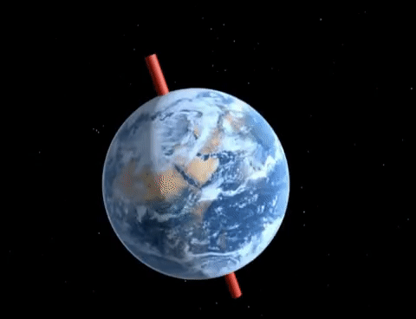
The Earth’s Rotation
-The Earth’s rotation on her axis presents the Sun and other Celestial Bodies to appear to proceed across the sky from East to West.
-If we measure the time interval between the transits between these celestial bodies, we would be measuring a period of the Earth’s rotation.
-The Earth’s rotation is a navigator’s standard of time.
-The Earth completes a full rotation (360°) over the course of a day, or approximately 24 hours
(actually 23 hours and 56 minutes).
SEANAV I United States Naval Academy
NN220 – Fundamentals of Navigation
Operations Officer I HMS PROTECTOR A173 I The Ice Patrol Ship

Slide 6
The Earth’s Rotation
-This means that different parts of the world are in different times of the day, depending on where they are on Earth and the rotation of the sun.
SEANAV I United States Naval Academy
NN220 – Fundamentals of Navigation
Operations Officer I HMS PROTECTOR A173 I The Ice Patrol Ship

Slide 7

How To Measure Time
-Most of us just use the clocks installed into our phones and smart watches.
-There is a mathematical approach to how time is measured and observed.
-The fundamentals are based on Apparent Solar Time, Mean Solar Time and the Equation of Time.
SEANAV I United States Naval Academy
NN220 – Fundamentals of Navigation
Operations Officer I HMS PROTECTOR A173 I The Ice Patrol Ship

Slide 8
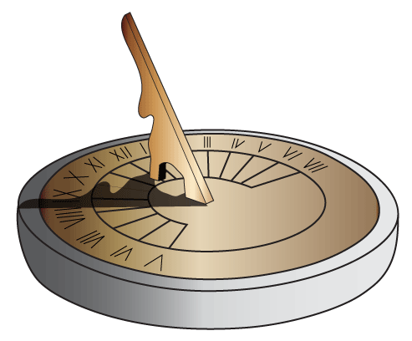
Apparent Solar Time
-Apparent Solar Time is the time we would have if a perfectly constructed and calibrated sun dial would read at a given location, based on the position of the Sun in the sky. -Seems like the ideal time to use, however it is not a uniform scale. -The apparent Sun crosses the sky at slightly different rates throughout the year. -This means that apparent time runs fast with regard to a constant time scale. It is not ideal for timekeeping. -So what do we do?
SEANAV I United States Naval Academy
NN220 – Fundamentals of Navigation
Operations Officer I HMS PROTECTOR A173 I The Ice Patrol Ship

Slide 9
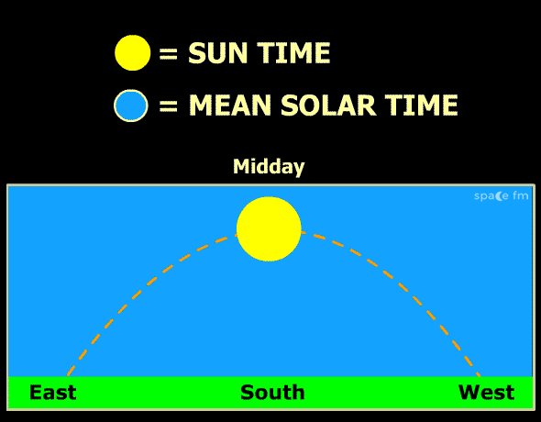
Mean Solar Time
-To create a uniform scale, we use mathematics to find the place where the sun should be if it moved at a constant rate throughout the sky, regardless of the time of year.
-Called “Fictitious” Mean Sun.
-Never more than 4° East or West of the actual Sun.
-Mean Solar Time is defined like Apparent Solar Time, but we use the fictitious position of the sun.
-Since we can’t see the fictitious sun, we use the Equation of Time, or the difference between Mean Solar Time and Apparent Solar Time on any given day.
SEANAV I United States Naval Academy
NN220 – Fundamentals of Navigation
Operations Officer I HMS PROTECTOR A173 I The Ice Patrol Ship

Slide 10
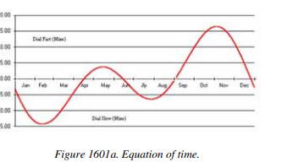
Equation of Time
-By knowing our Apparent Solar Time and the Equation of Time, we can find Mean Solar Time. -The equation of time can vary depending on the time of year. In mid-February the value is almost -14 minutes 13 seconds and + 16 minutes and 26 seconds in early November. -This information can be found in the Nautical Almanac. -Apparent Time = Mean Time +/- Equation of Time.
SEANAV I United States Naval Academy
NN220 – Fundamentals of Navigation
Operations Officer I HMS PROTECTOR A173 I The Ice Patrol Ship

Slide 11
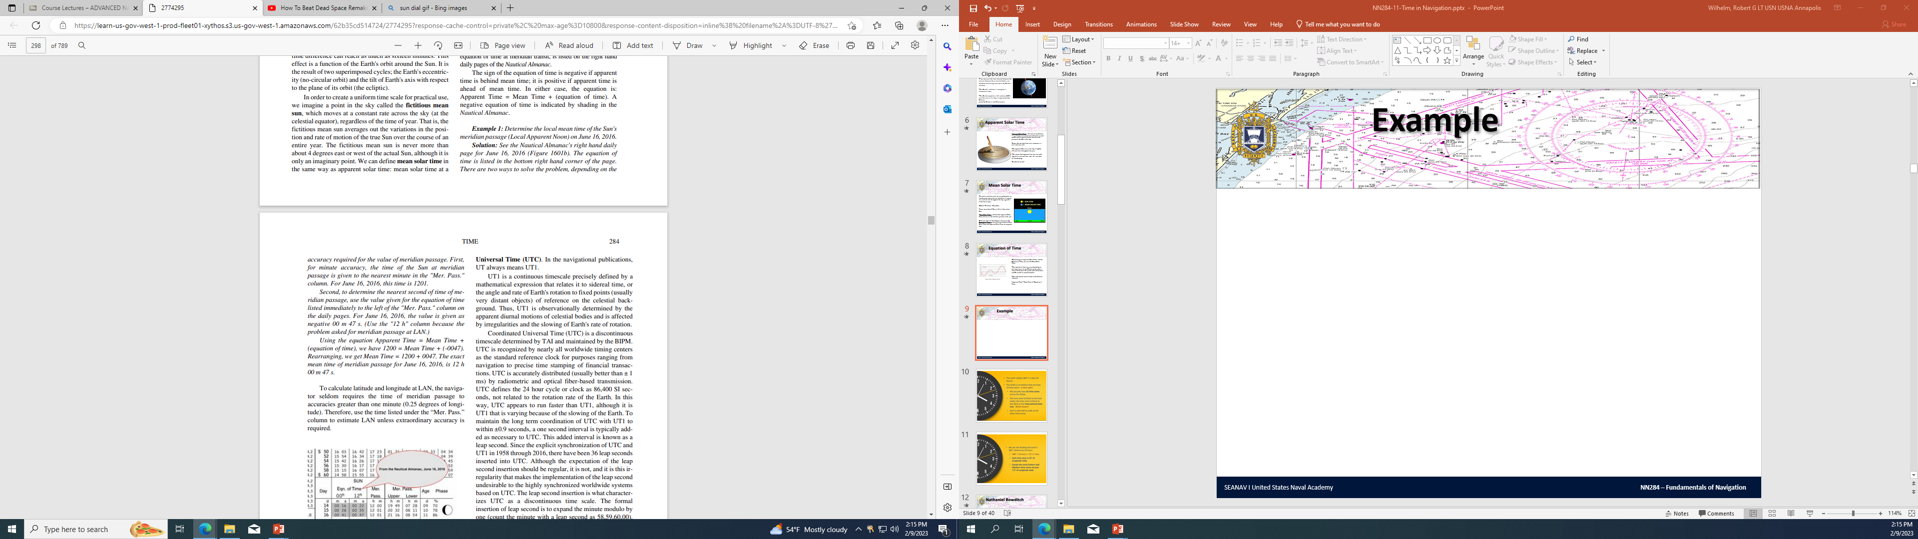
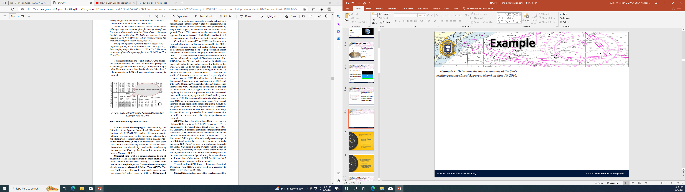
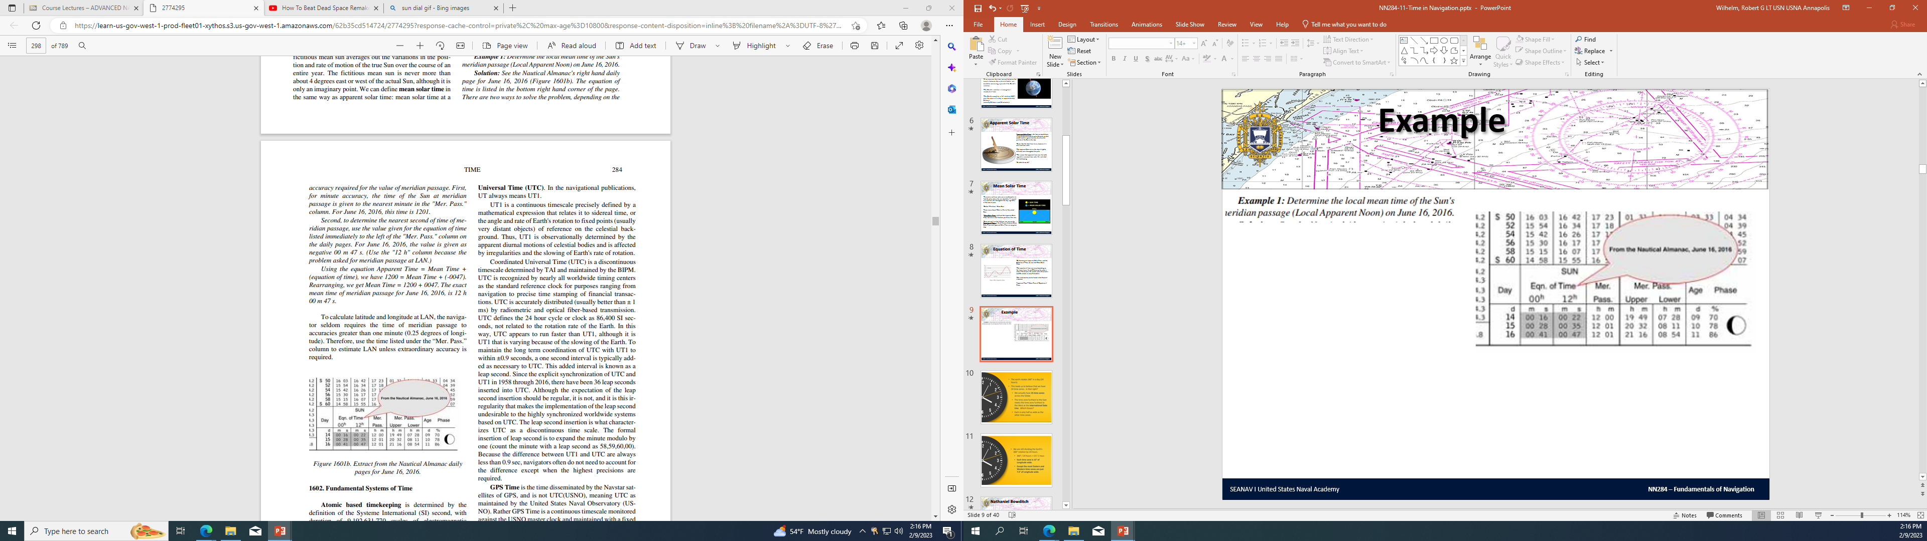
Example
The Gray highlight means it is a subtracted time!
SEANAV I United States Naval Academy
NN220 – Fundamentals of Navigation
Operations Officer I HMS PROTECTOR A173 I The Ice Patrol Ship

Slide 12
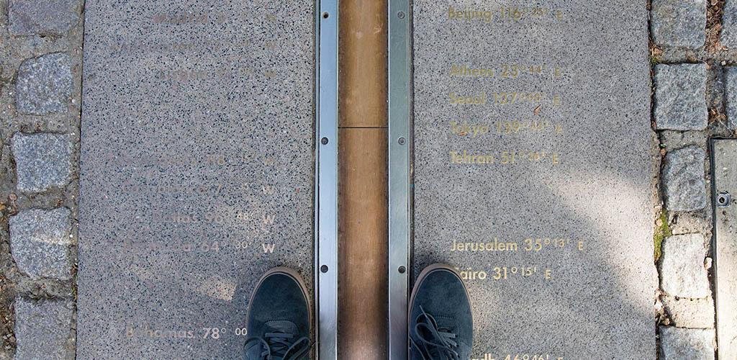
Create a Foundation
-Equipped with the information needed to determine Mean Solar Time, we can determine the time around the world based on the fictitious movement of the sun. -This allows a more consistent method of measuring time, not accounting for the shifts of the apparent sun’s movement throughout the year. -A reference point is needed to be created to based time around. -That reference is the Greenwich Meridian, or the Prime Meridian.
SEANAV I United States Naval Academy
NN220 – Fundamentals of Navigation
Operations Officer I HMS PROTECTOR A173 I The Ice Patrol Ship

Slide 13
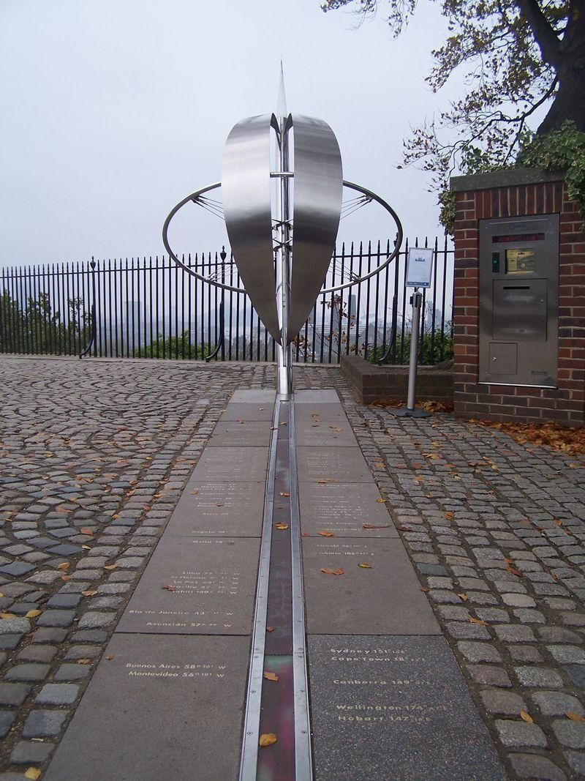
Greenwich Mean Time
-Greenwich Mean Time (GMT) is widely used as the mean solar time at zero longitude, or the Prime Meridian.
-Based in Greenwich, UK.
-Called Zulu (Z), GMT, UT, UTC, and UT1. They all mean the same thing.
-Is the generic reference to the timescale that approximates mean diurnal motion of the fictitious sun.
-In navigation, Zulu is the standard to which we base all the time zones of the world.
SEANAV I United States Naval Academy
NN220 – Fundamentals of Navigation
Operations Officer I HMS PROTECTOR A173 I The Ice Patrol Ship

Slide 14
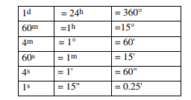
Time and Longitude Arc
-The navigator may be required to convert the measure of longitude arc to time or vice versa. -Remember that longitude is a function of time. -Mean Solar Day = one complete rotation of the Earth or 360°. -One rotation of the Earth = one 24 hour period. -One 24 hour period = 1440 minutes. -60 minutes =15° of longitude. 15° = one timezone! (with some exceptions including the International Date Line)
SEANAV I United States Naval Academy
NN220 – Fundamentals of Navigation
Operations Officer I HMS PROTECTOR A173 I The Ice Patrol Ship

Slide 15
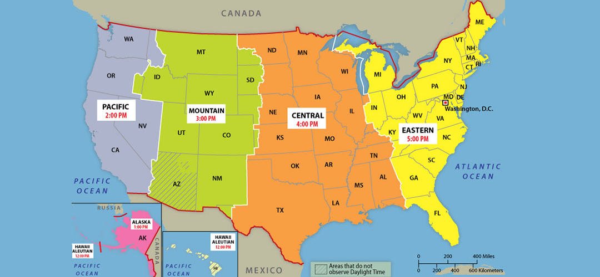
Time Zones
- 23 of time zones are 15° wide.
Prime Meridian
030º W
015º W
015º E
030º E
037.5 °W
022.5 °W
007.5°W
007.5°E
022.5°E
037.5°E
7.5°
7.5°
15°
O
+ 2
N
+ 1
Z
0
A
- 1
B
- 2
Subtract(-) 1 Hour
Add(+) 1 Hour
Add(+) Hours
Subtract(-) Hours

Slide 16


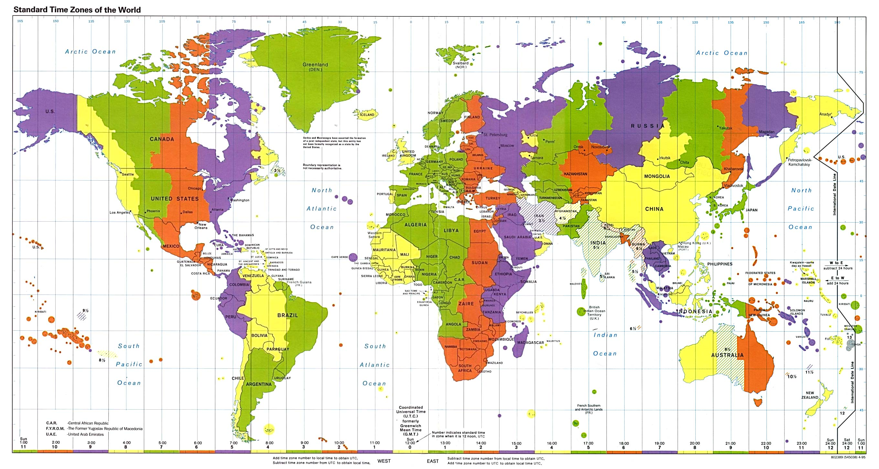



West of Z (N-Y) is “+”
East of Z (A-M) is “-”
X
W
V
U
T
S
R
Q
P
O
N
Z
A
B
C
D
E
F
G
H
I
K
L
M
Y
+11
+10
+9
+8
+7
+6
+5
+4
+3
+2
+1
-1
-2
-3
-4
-5
-6
-7
-8
-9
-10
-11
-12
+12
“J” ; missing!! Refers to current local time of
the observer
“M” ,”Y” ; the same time, but different days
“Z” ;the reference for all others
International Date Line; located at 180°
The Sun travels 360° in 24 hours.
There are 25 of time zones all around the world.

Slide 17
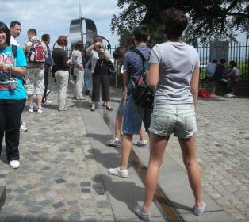
Time Zones
- 23 of time zones are 15° wide.
Prime Meridian
030º W
015º W
015º E
030º E
037.5 °W
022.5 °W
007.5°W
007.5°E
022.5°E
037.5°E
7.5°
7.5°
15°
O
+ 2
N
+ 1
Z
0
A
- 1
B
- 2
Subtract(-) 1 Hour
Add(+) 1 Hour
X
W
V
U
T
S
R
Q
P
O
N
Z
A
B
C
D
E
F
G
H
I
K
L
M
Y
+11
+10
+9
+8
+7
+6
+5
+4
+3
+2
+1
-1
-2
-3
-4
-5
-6
-7
-8
-9
-10
-11

Slide 18
Time Zones
- 02 of time zones are 7.5° wide Y and M.
International Date Line
150º E
165º E
180º
165º W
150º W
142.5° E
157.5°E
172.5°E
172.5°W
157.5°W
142.5°W
7.5°
7.5°
15°
K
-10
L
-11
M
-12
Y
+12
X
+11
W
+10
Add(+) 1 Day
Subtract(-) 1 Day
X
W
V
U
T
S
R
Q
P
O
N
Z
A
B
C
D
E
F
G
H
I
K
L
M
Y
+11
+10
+9
+8
+7
+6
+5
+4
+3
+2
+1
-1
-2
-3
-4
-5
-6
-7
-8
-9
-10
-11

Slide 19
Determine Time Zones Geographically
If you did not know the local time zone of a specific location what could you do?
Longitude derives time zone.
Example: San Diego - 117° 10’ W
Convert longitude into degrees→ 10’ 1° = .167° + 117°= 117.167°W
60’
Covert degrees into hours→ 117.167° 1 hr = 7.8 hrs West
15°
Round to nearest whole number→ 8 hrs western hemisphere... +8U (it is + because it is in the West)
SEANAV I United States Naval Academy
NN220 – Fundamentals of Navigation
Operations Officer I HMS PROTECTOR A173 I The Ice Patrol Ship

Slide 20
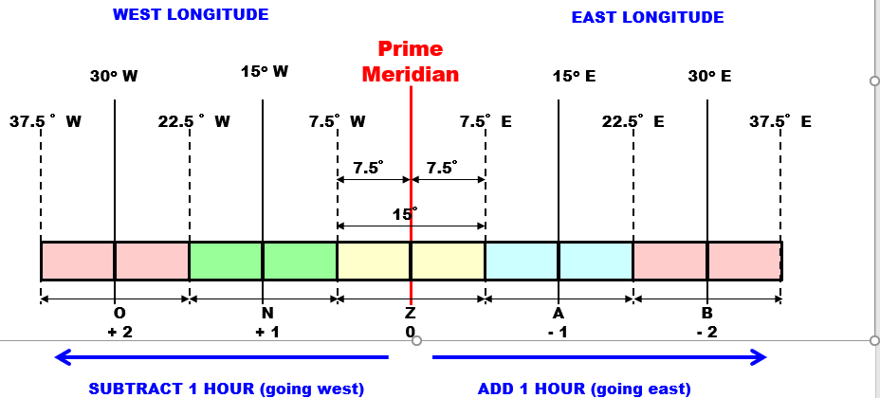
Zone Description
-Your ZD is used to find your time zone in reference to Z (GMT). -In Annapolis we are +5R. -We would take our local time, add 5 hours, and we would know what time GMT would be at. -ZD’s N(+1) to Y(+12) (WESTward) and A(-1) to M(-12) (EASTward) – except “J”
SEANAV I United States Naval Academy
NN220 – Fundamentals of Navigation
Operations Officer I HMS PROTECTOR A173 I The Ice Patrol Ship

Slide 21
Zone Description
-Each time zone will have a letter of the alphabet and a number assigned to it. -The exception for the alphabet is “J”, which not a timezone. -These letters and numbers are called your Zone Description (ZD). -In Annapolis, our ZD is +5R
SEANAV I United States Naval Academy
NN220 – Fundamentals of Navigation
Operations Officer I HMS PROTECTOR A173 I The Ice Patrol Ship

Slide 22
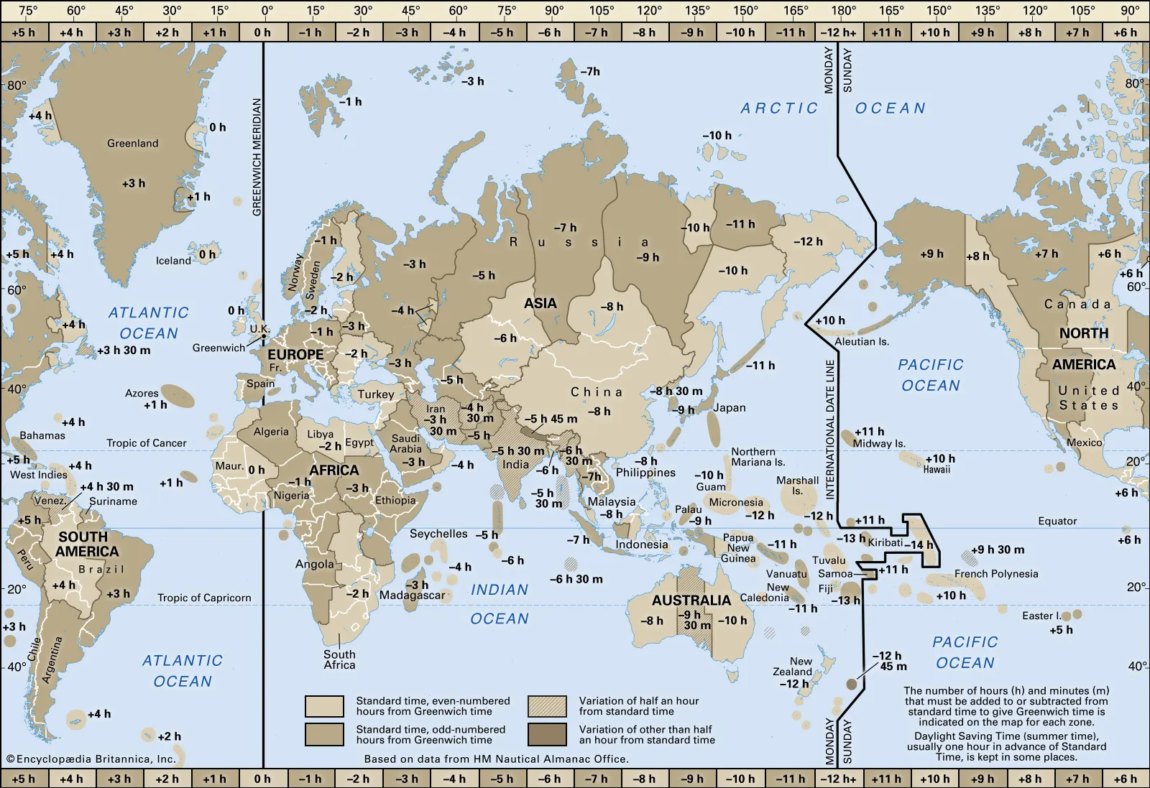
The International Date Line
-Since time accumulates differently depending on whether you are traveling East or West, a traveler circling the Earth will lose or gain a day. -To provide a starting point, a meridian (sort of…) was drawn and fixed by an informal agreement, called the International Date Line. -The IDL separates two consecutive calendar days. -You lose a day traveling east across the IDL. -You gain a day traveling west across the IDL.
SEANAV I United States Naval Academy
NN220 – Fundamentals of Navigation
Operations Officer I HMS PROTECTOR A173 I The Ice Patrol Ship

Slide 23
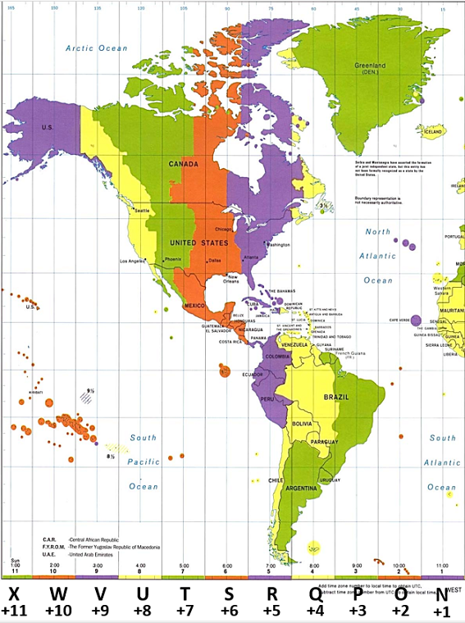
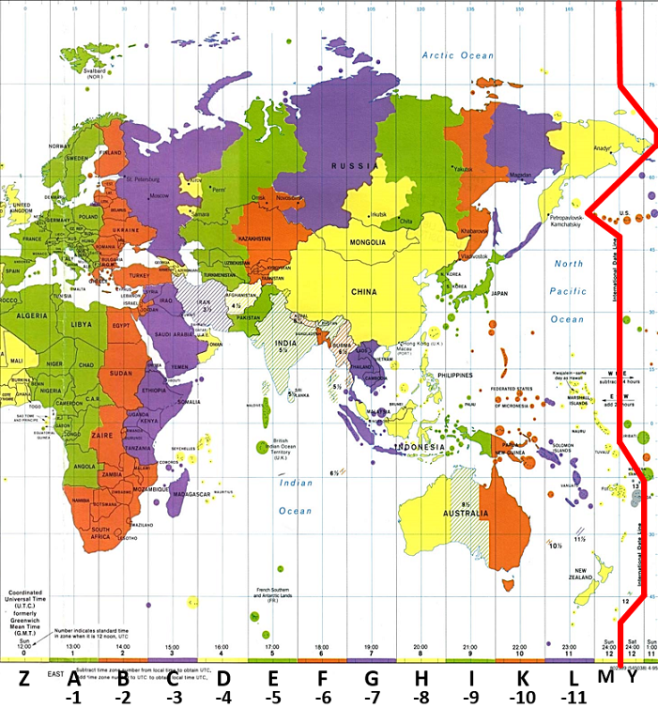
Time Zones
San Diego
Manila
“If it’s SUNday in SAN Diego,
it’s MONday in MANilla”
Add(+) 1 Day
Subtract(-) 1 Day

Slide 24
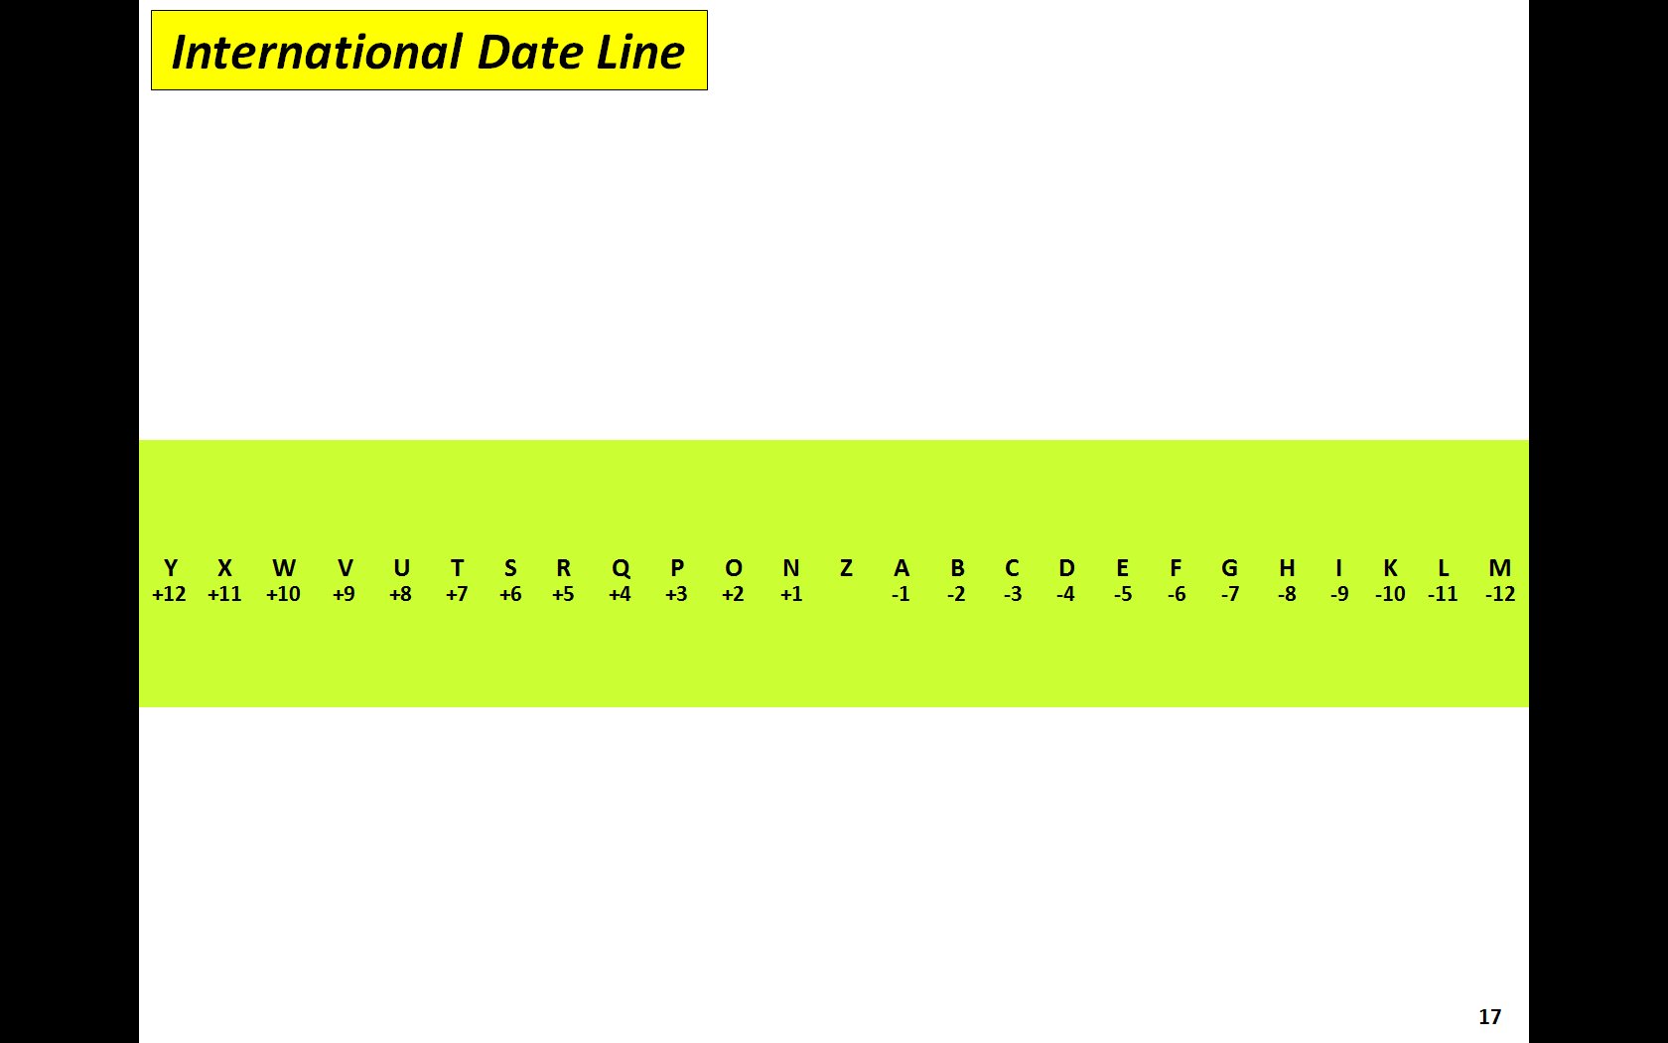
Practice
Q1: What is the complete Zone Description for 075º 00’00”W ?
075º 00’00”W / 15° =
5
+5R
24

Slide 25
Practice
Q3: What is the complete Zone Description for 127 º 35’00”W ?
Q2: What is the complete Zone Description for 127 º 00’00”W ?
Q3: What is the complete Zone Description for 157 º 40’00”E ?
157 º 40’00”E / 15° =
157.66 º E / 15°
11
= 10.51...
Round up or down based on 0.5
40 ‘ / 60 = 0.6666…
157°40’E
157.66…°E
-11L
25

Slide 26
The Sun daily travels westbound from IDL
260830Y
261230U
261530R
Greenwich
262030Z
270530i
270830M
Annapolis
(Time zone = R)
Tokyo
(Time zone = I)
San Diego
(Time zone = U)
X
W
V
U
T
S
R
Q
P
O
N
Z
A
B
C
D
E
F
G
H
I
K
L
M
Y
+11
+10
+9
+8
+7
+6
+5
+4
+3
+2
+1
-1
-2
-3
-4
-5
-6
-7
-8
-9
-10
-11
-12
+12

Slide 27
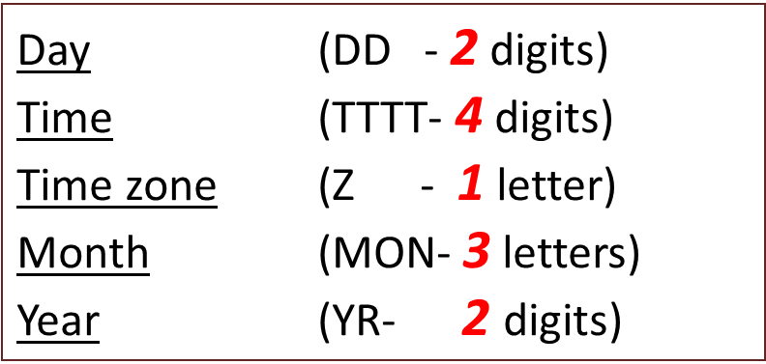
Practice
Q4: If it is 0800 in Annapolis, MD (+5R) on 26 February 2018, what time is that in Perth, Australia (-8H) ?
Time zone “H” is ahead of “R” for
13 hours.
+13 hours
0800, 26 February 2018
262100HFEB18
+) 13 (hours)
2100, 26 February 2018 (-8H)
27

Slide 28
Practice
Q5: If it is 0800 in Annapolis, MD (+5R) on 26 February 2018, what time is that in Pearl Harbor, HI (+10W) ?
Time zone “W” is behind “R” for
5 hours.
-5 hours
0800, 26 February 2018
260300WFEB18
-) 5 (hours)
0300, 26 February 2018 (+10W)
28

Slide 29
Convert the Longitude to Time
-Our longitude at USNA is 076° 29’ 00’’. -Arc to time conversion…convert seconds and minutes to decimals. -29’/60 (60 minutes in an hour) = .4333333. -Longitude is converted to 076.4333333°. -076.4333333°/15 (number of degrees in an hour) = 5.096 hours. -USNA is 5 hours and 5 minutes and 56 seconds away from the base longitude of the Prime Meridian!
SEANAV I United States Naval Academy
NN220 – Fundamentals of Navigation
Operations Officer I HMS PROTECTOR A173 I The Ice Patrol Ship

Slide 30
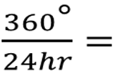
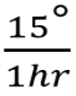
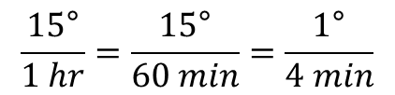
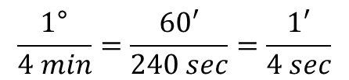
Arc to Time Conversion
The Sun goes around the Earth per 24 hours.
ARC | Time
1/15
15°
1 hr (60min)
1/15
1°
(60’)
4
min
1/60
1/60
1’
4 sec
This information was essential to early navigation!
By knowing the time at your home port and the time where you are (based on the Sun’s position), you could calculate how many degrees of longitude separated you and therefore determine your location east or west of your origin (or the prime meridian).

Slide 31
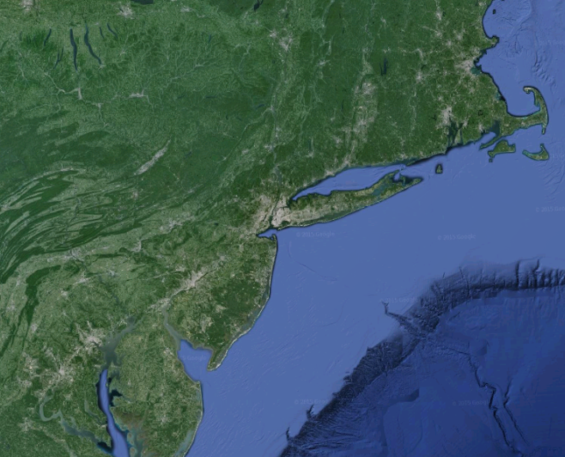
Practice
Q7: If sunrise occurs at 0620 in Boston, MA (071°05’W),
what time will the sunrise in Annapolis, MD (076°28’W)?
Difference between Boston and Annapolis is…
5°23’
21 min 32 sec
ARC | Time
5° = 5(°)* 4(min)
= 20 min
15°
1 hr (60min)
076°28’W
-) 071°05’W
5°23’W
23’ = 23(’) * 4(sec)
= 92 seconds
= 1 min 32 sec
1°
(60’)
4
min
1’
4 sec
Boston
Boston
Annapolis is 21 min 32sec BEHIND Boston.
21 min 32 sec
06-20-00 + 0-21-32 =
06-41-32
Annapolis
31
31

Slide 32
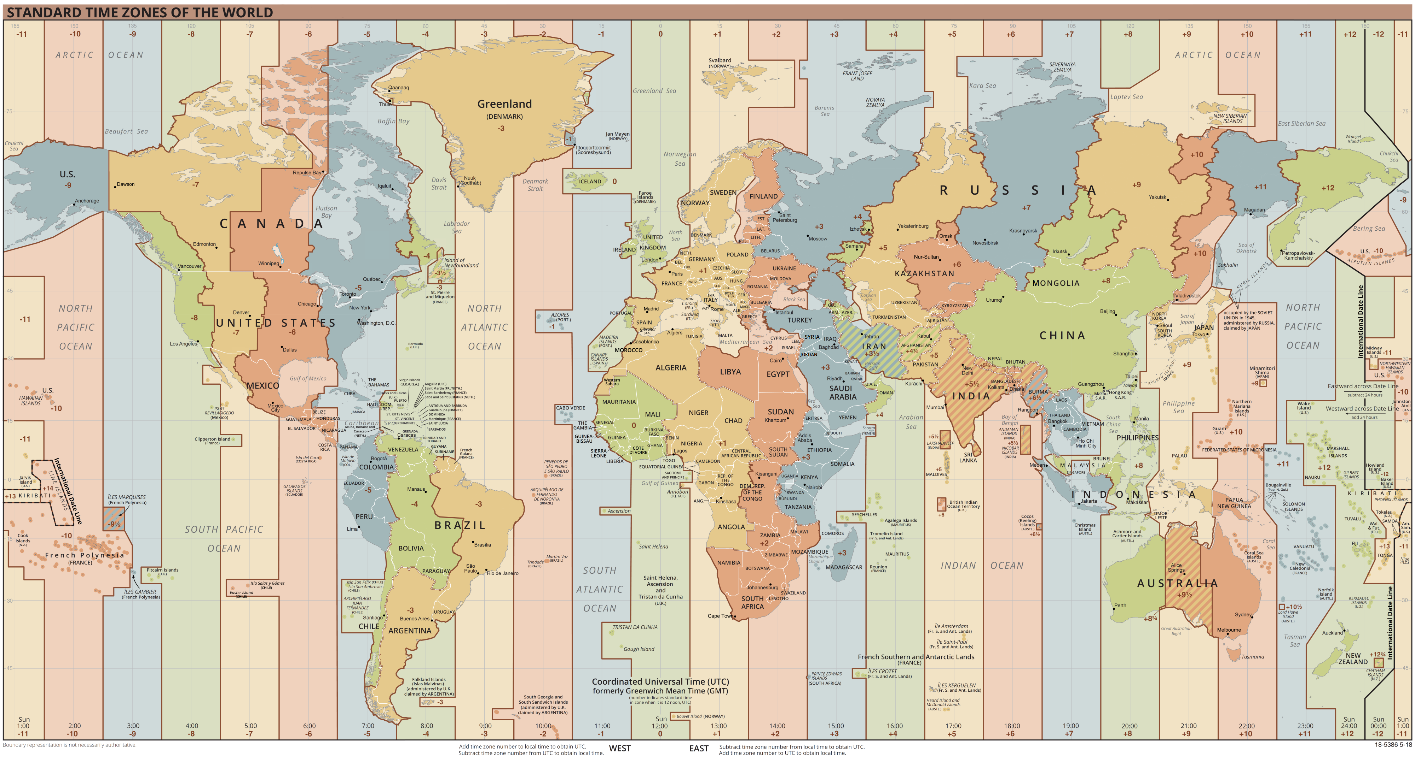

Slide 33
Determine Time Zones Geographically
This method is not always accurate.
Due to social/political/economic reasons, some countries will not honor their geographic time zone.
Iceland goes by Z and should be +1N.
Iran goes by 3.5 hours….when everyone is on the hour they are on the half hour!
SEANAV I United States Naval Academy
NN220 – Fundamentals of Navigation
Operations Officer I HMS PROTECTOR A173 I The Ice Patrol Ship

Slide 34
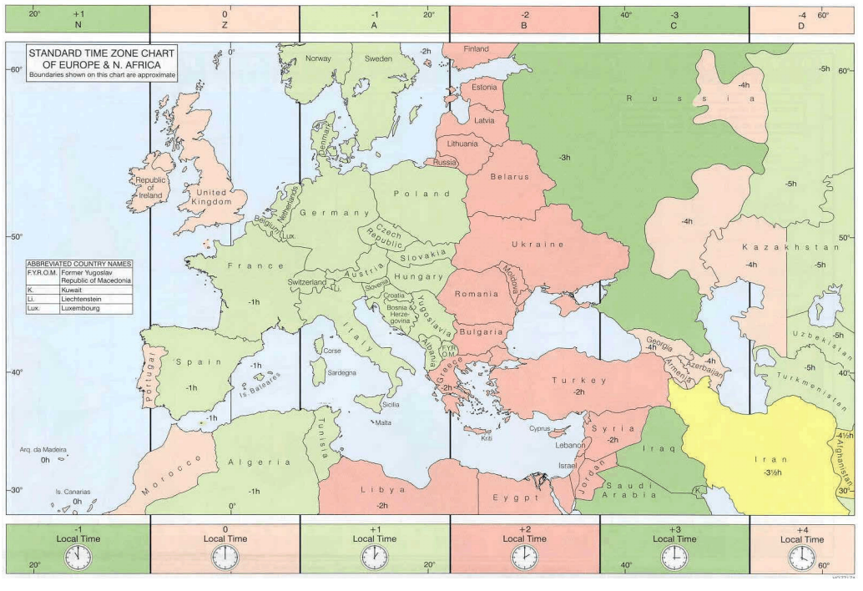

Slide 35
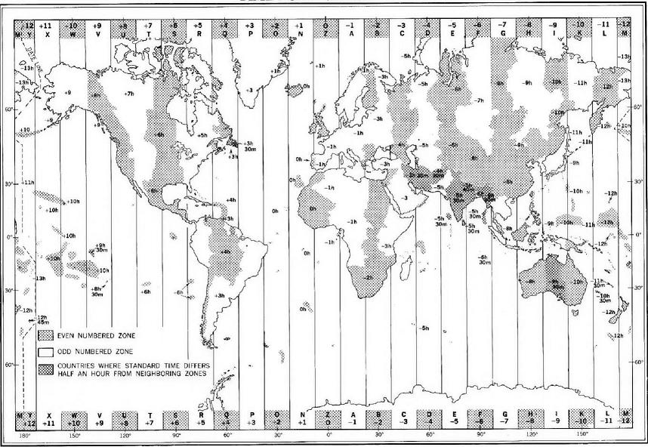
Each Timezone = 15°Longitude
Except M / Y = 7.5°each (15°total)
Washington DC
+5R
West is Best
Add 5hrs to return to Z
1200R = 1700Z
Bahrain
-4D
East is Least
Minus 4hrs to return to Z
2100D = 1700Z

Slide 36
Daylight’s Savings Time
-Daylight Savings. As a result of the early rising of the sun in summer, a certain amount of daylight would be lost if time zones were not adjusted. -To avoid this loss, it is customary to adopt the time of the next adjacent zone to the east during a portion of the year. -This results in sunrise and sunset occurring one hour later by the clock. -In the summer months, we “Spring forward” one time zone towards Zulu. -In the winter months, we “Fall back” one time zone from Zulu. -Legal times for countries may differ to align with bigger neighbors!
SEANAV I United States Naval Academy
NN220 – Fundamentals of Navigation
Operations Officer I HMS PROTECTOR A173 I The Ice Patrol Ship

Slide 37
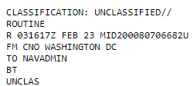
Military’s Standard Use
-The U.S. Military makes standard use of Z time. -Since forces are dispersed around the world, it’s easier to use the base reference time. -You have seen it before….
SEANAV I United States Naval Academy
NN220 – Fundamentals of Navigation
Operations Officer I HMS PROTECTOR A173 I The Ice Patrol Ship

Slide 38
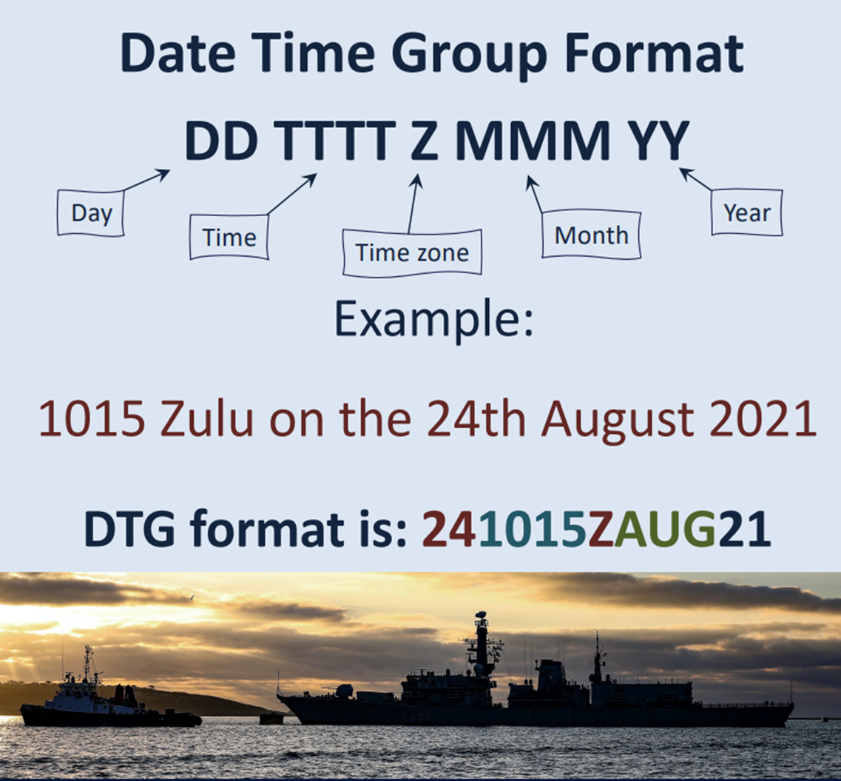

Slide 39
Let’s Practice
-The concept of time in navigation is especially critical as we transit vast oceans and cross multiple time zones. -Let’s work a hypothetical scenario and use all the tools together.
SEANAV I United States Naval Academy
NN220 – Fundamentals of Navigation
Operations Officer I HMS PROTECTOR A173 I The Ice Patrol Ship

Slide 40
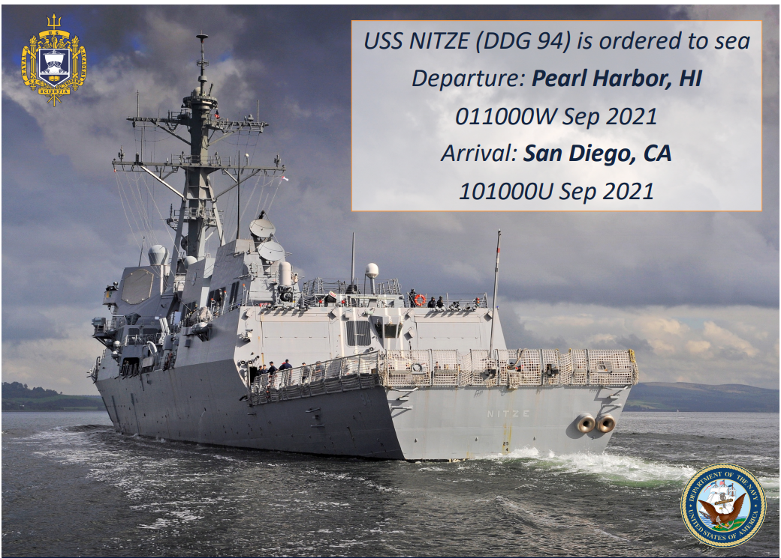

Slide 41
Let’s Practice
-Our DESRON has ordered us to sea. -We were presented with a time to depart Pearl Harbor, HI and a time to arrive in San Diego, CA. -This is common tasking. -Our time to depart is called our Estimated Time of Departure (ETD) and our arrival time is called our Estimated Time of Arrival (ETA). -Since we are given our ETA and ETD, we must determine our Speed of Advance (SOA) or how fast we would need to go to get to our destination on time.
SEANAV I United States Naval Academy
NN220 – Fundamentals of Navigation
Operations Officer I HMS PROTECTOR A173 I The Ice Patrol Ship

Slide 42
Prepare the Voyage Plan
1. Determine port of departure/arrival, date of departure/arrival (Done!) 2. Determine Chart and Publication requirements 3. Determine Distance and SOA 4. Plan the passage
SEANAV I United States Naval Academy
NN220 – Fundamentals of Navigation
Operations Officer I HMS PROTECTOR A173 I The Ice Patrol Ship

Slide 43
Determine Charts and Publication Requirements
-Identify that you have the most recent DNC or ENC libraries to support the transit. -Apply the VDU corrections and ensure that both your charts and navigation equipment is aligned to WGS-84. -Do your research on the voyage using such publications as PUB 151, Coast Pilots, Sailing Directions, Pilot Charts, etc.
SEANAV I United States Naval Academy
NN220 – Fundamentals of Navigation
Operations Officer I HMS PROTECTOR A173 I The Ice Patrol Ship

Slide 44
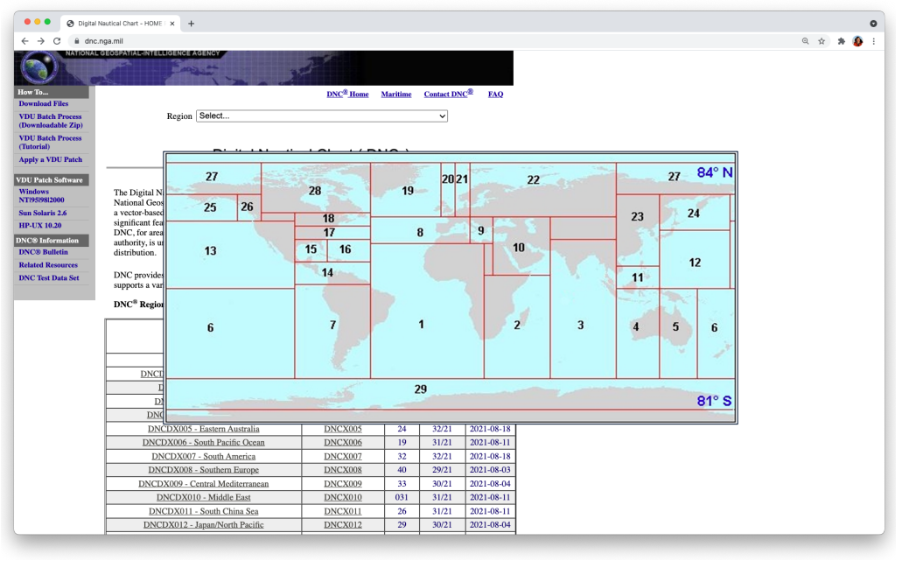
Digital Nautical Chart - HOME PAGE (nga.mil)

Slide 45
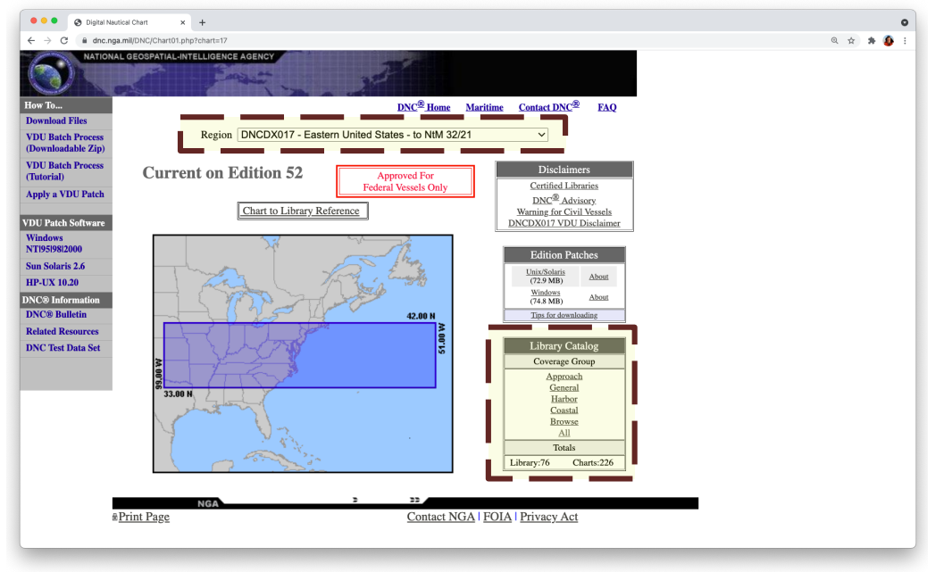
Digital Nautical Chart - HOME PAGE (nga.mil)

Slide 46
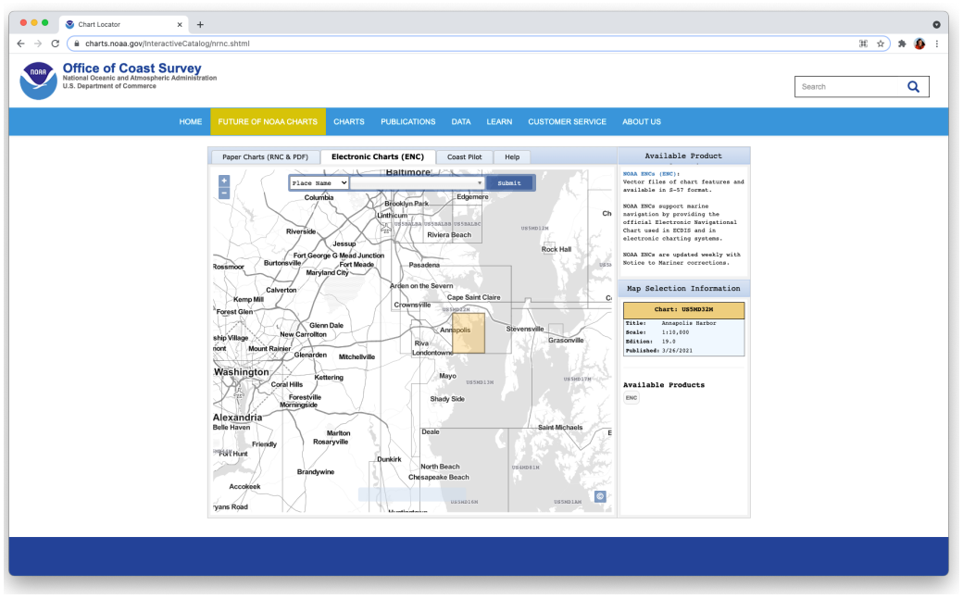
Chart Locator (noaa.gov)

Slide 47
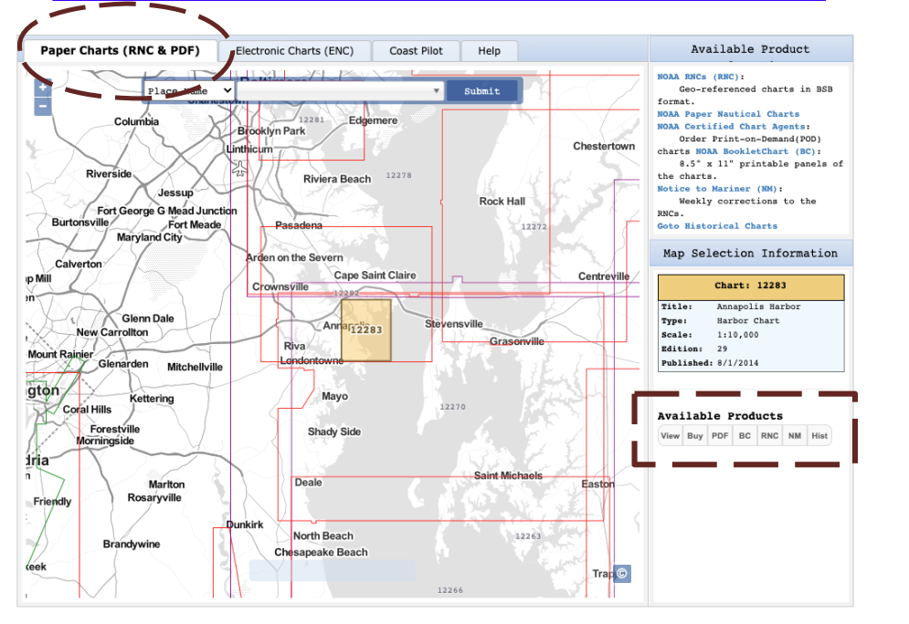

Slide 48
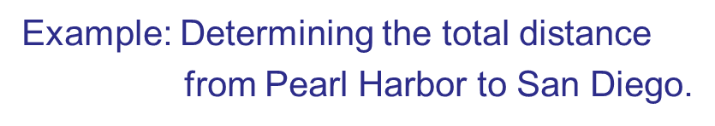
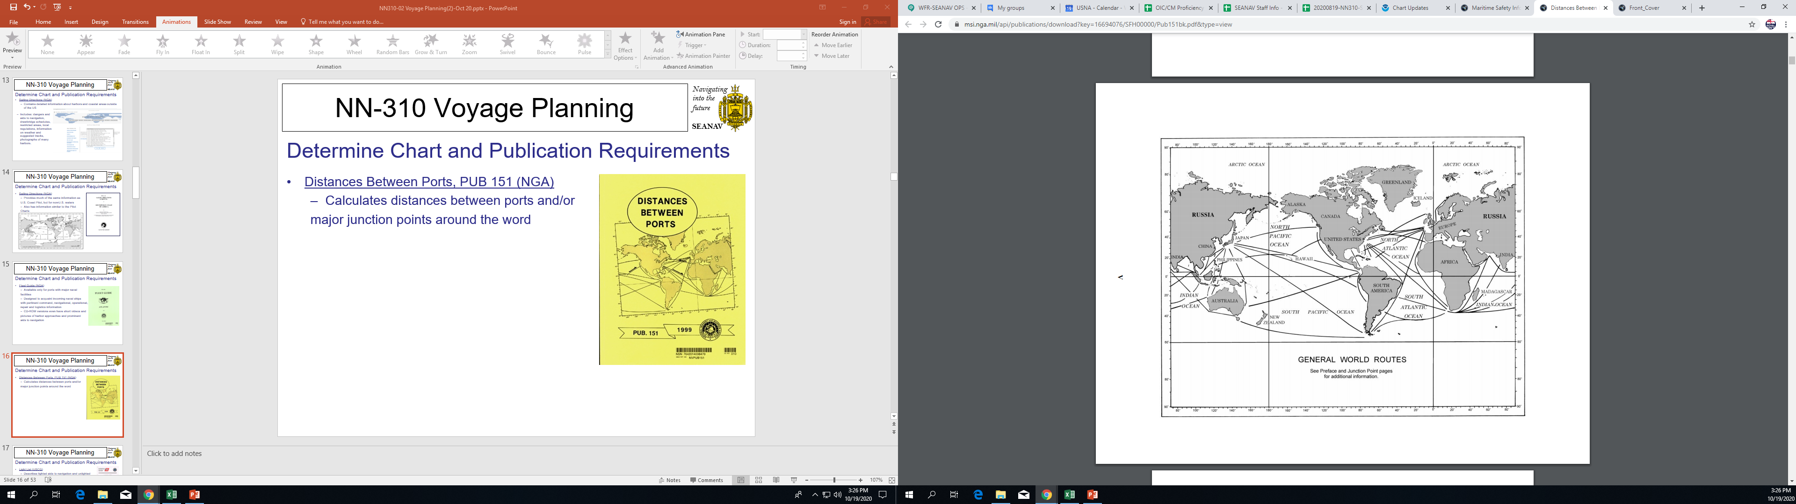
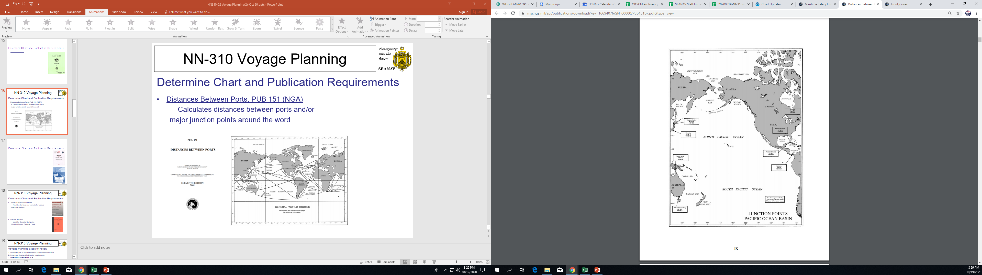
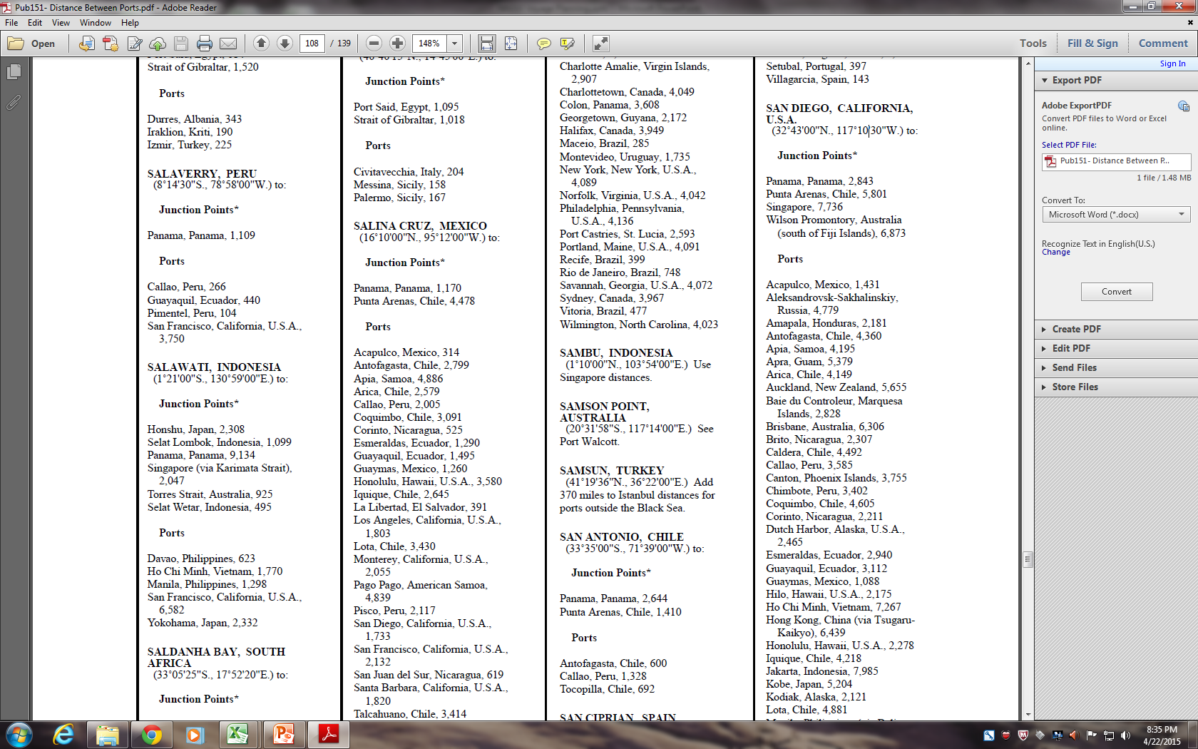
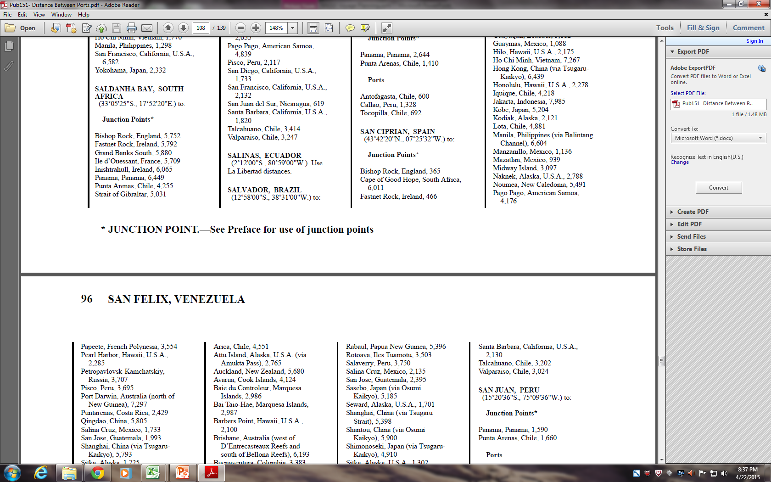
ALWAYS START AT PORT OF DEPARTURE!
Page 95
Page 96

Slide 49
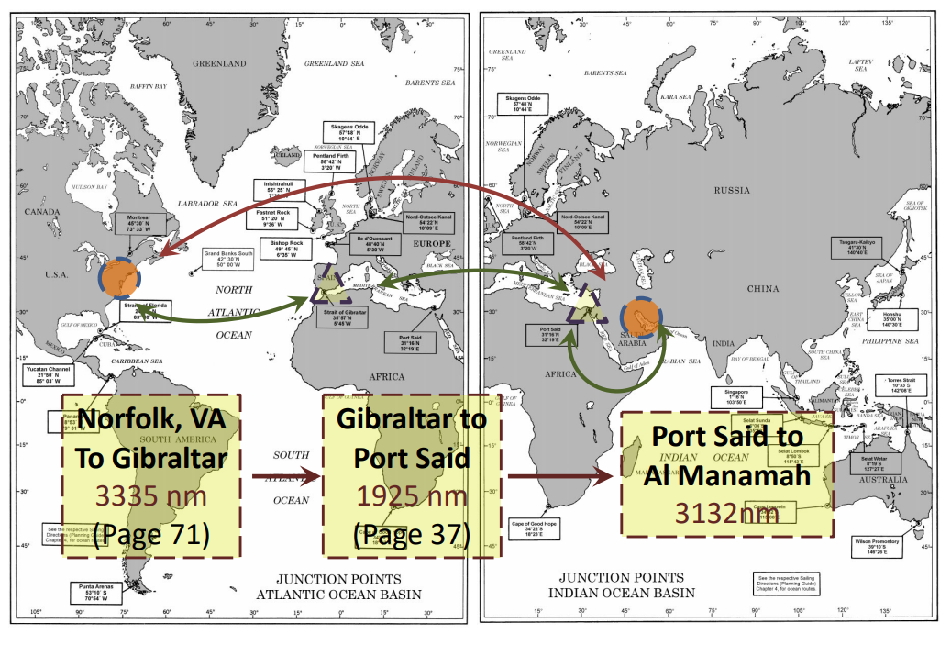
Example: Determining the distance from Norfolk, VA to Al Manamah, Bahrain by using Junction Points

Slide 50
Prepare the Voyage Plan
1. Determine port of departure/arrival, date of departure/arrival (Done!) 2. Determine Chart and Publication requirements (Done!) 3. Determine Distance and SOA 4. Plan the passage
SEANAV I United States Naval Academy
NN220 – Fundamentals of Navigation
Operations Officer I HMS PROTECTOR A173 I The Ice Patrol Ship

Slide 51
Time, Speed, Distance
-Time, Speed, and Distance is critical in building navigation plans. Distance (NM) = Time (HRS) X Speed (KTS) -If you have two of these, you can find the other. -In our example, we are given the time requirements and we can find the distance from PUB 151, so we are solving for the SOA needed. -When working these problems, read the instructions carefully to determine what needs to be solved.
SEANAV I United States Naval Academy
NN220 – Fundamentals of Navigation
Operations Officer I HMS PROTECTOR A173 I The Ice Patrol Ship

Slide 52
Determine Distance and SOA
-Based on PUB 151, the distance between Pearl Harbor and San Diego is 2,285NM. -ETD is 011200WSEP21 -ETA is 101200USEP21 -Convert the time zones to ZULU. -ETD = 011200WSEP21 (+10W) = 012200ZSEP21 -ETA = 101200USEP21 (+8U) = 102000ZSEP21
SEANAV I United States Naval Academy
NN220 – Fundamentals of Navigation
Operations Officer I HMS PROTECTOR A173 I The Ice Patrol Ship

Slide 53
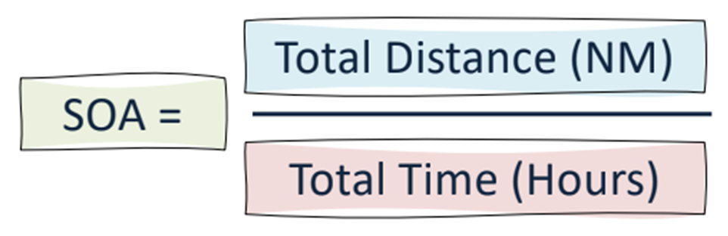
Determine Distance and SOA
-Difference between ETD and ETA will give you TOTAL TRANSIT TIME. -012200ZSEP21 to 102000ZSEP21 = 8 days and 22 hours -Convert to hours = (24 x 8) = 22 = 214 hours -SOA = 2285NM / 214 Hours = 10.67 Knots (We would round up to 11 knots)
SEANAV I United States Naval Academy
NN220 – Fundamentals of Navigation
Operations Officer I HMS PROTECTOR A173 I The Ice Patrol Ship

Slide 54
Prepare the Voyage Plan
1. Determine port of departure/arrival, date of departure/arrival (Done!) 2. Determine Chart and Publication requirements (Done!) 3. Determine Distance and SOA (Done!) 4. Plan the passage
SEANAV I United States Naval Academy
NN220 – Fundamentals of Navigation
Operations Officer I HMS PROTECTOR A173 I The Ice Patrol Ship

Slide 55
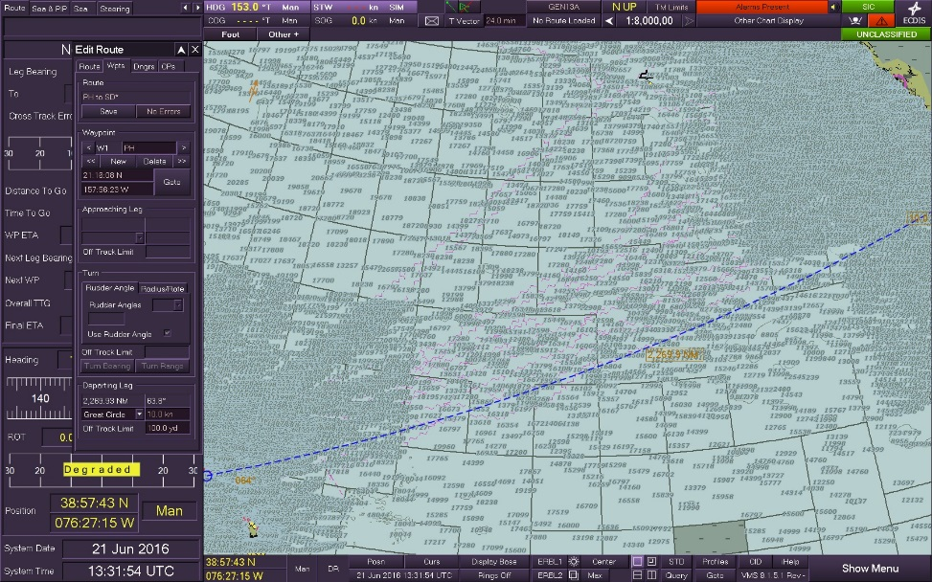

Slide 56
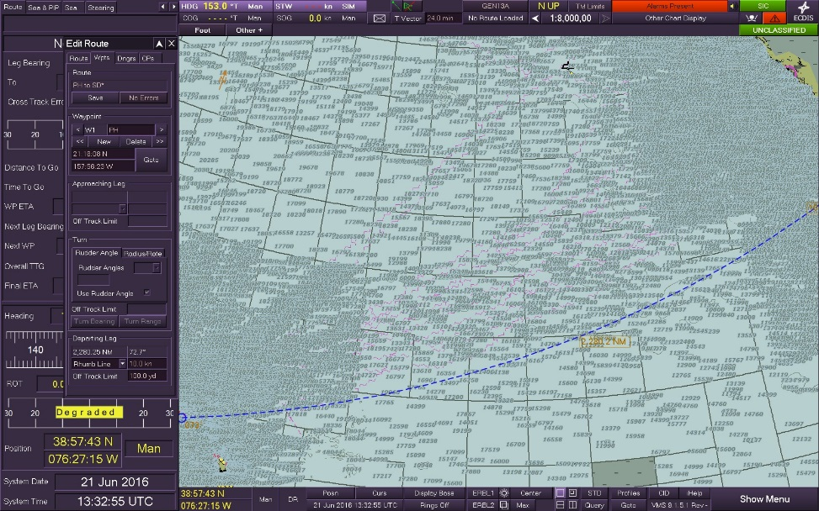

Slide 57
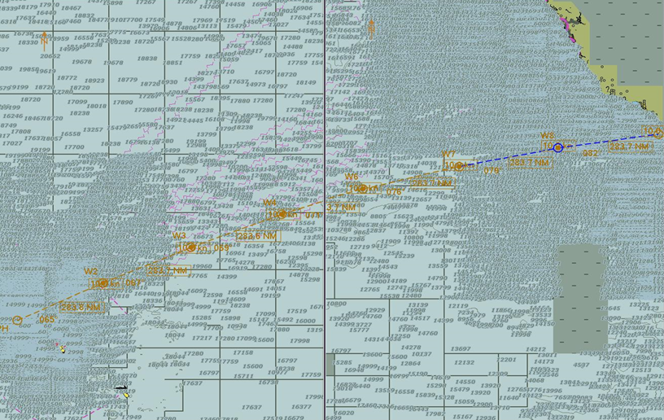
Divide route into legs, no more than 350-400 NM each.
Change each of the legs from GCs to RLs.

Slide 58
160◦
155◦
150◦
145◦
140◦
135◦
130◦
125◦
120◦
50◦
Essentially, you’ve broken up a Great Circle track into smaller legs using Rhumb Lines to form a Composite Track.
This allows for steadying courses, while still driving the shortest distance.
45◦
40◦
35◦
Composite Track 2270 NM
30◦
Rhumb Line 2280 NM
25◦
20◦

Slide 59
Prepare the Voyage Plan
1. Determine port of departure/arrival, date of departure/arrival (Done!) 2. Determine Chart and Publication requirements (Done!) 3. Determine Distance and SOA (Done!) 4. Plan the passage (Done!)
SEANAV I United States Naval Academy
NN220 – Fundamentals of Navigation
Operations Officer I HMS PROTECTOR A173 I The Ice Patrol Ship

Slide 60
Enabling Objectives
1 – UNDERSTAND time as a function of the Earth’s rotation around the sun. 2 - DEFINE Apparent Time and Mean Solar Time. 3 - UNDERSTAND Universal Time (GMT or Greenwich Meridian) and its application to time. 4 - UNDERSTAND Longitude Arc and arc to time conversion. 5 - UNDERSTAND the purpose of the International Date Line. 6 - DEFINE Zone Time (ZT) and Zone Description (ZD). 7 - DETERMINE zone time and make zone time conversions. 8 - UNDERSTAND the time zones, their division and the military’s standard use of Zulu time. 9 - DEFINE Speed of Advance (SOA), Estimated Time of Arrival (ETA), and Estimated Time of Departure (ETD). 10 - DETERMINE the distance between ports using PUB 151. 11 - COMPUTE SOA, ETA, ETD and apply zone time conversion required for voyage planning.
SEANAV I United States Naval Academy
NN220 – Fundamentals of Navigation
Operations Officer I HMS PROTECTOR A173 I The Ice Patrol Ship

Slide 61

Questions?
SEANAV I United States Naval Academy
NN220 – Fundamentals of Navigation
Operations Officer I HMS PROTECTOR A173 I The Ice Patrol Ship

